Slide 1
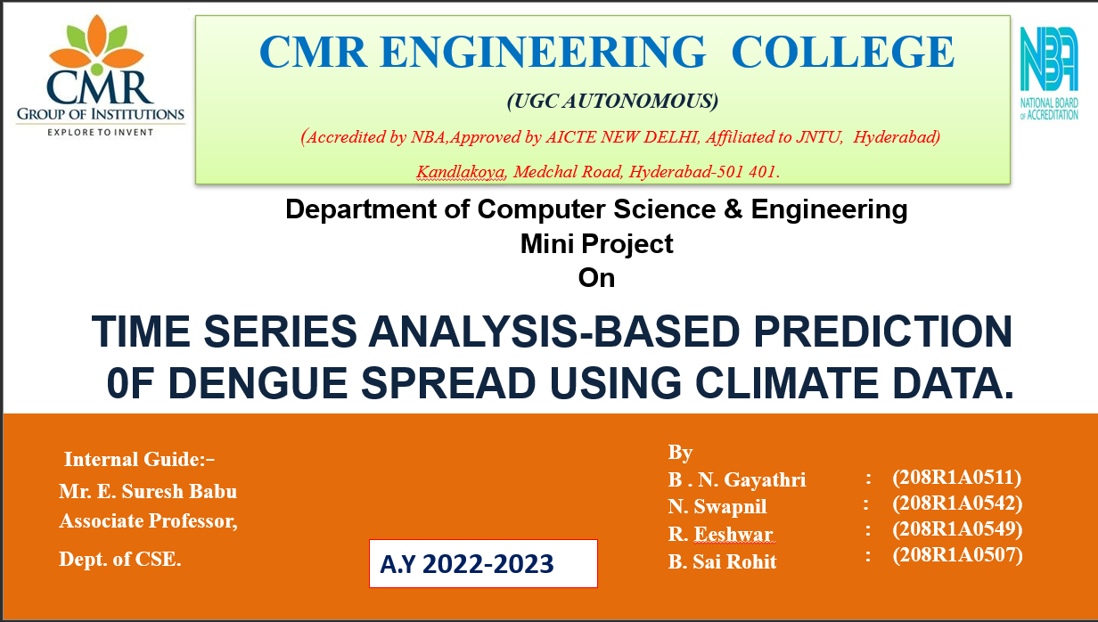

Slide 2
TABLE OF CONTENTS
Hardware Requirements
Use Case Diagram
Sequence Diagram
Testing Technique
Conclusion
Future Enhancement
References
Abstract
Introduction
Existing System
Limitations
Proposed System
Literature Survey
Software Requirements

Slide 3
ABSTRACT
Dengue is a vector-borne disease that poses a significant public health threat in tropical and subtropical regions, where the transmission is strongly influenced by climate factors. In this study, we propose a time series analysis-based approach to forecast the spread of dengue using climate data.
We obtained monthly climate data, including temperature, rainfall, and humidity, from meteorological stations in the study area. We also collected data on the incidence of dengue cases from local health authorities. We then applied time series analysis techniques to model the relationship between climate variables and dengue incidence.
Our results demonstrate that the proposed approach can accurately forecast the spread of dengue using climate data. We found that temperature and rainfall are the most significant predictors of dengue transmission, with higher temperatures and rainfall positively associated with the incidence of dengue cases.
Overall, our study provides evidence that time series analysis can be an effective tool for predicting the spread of dengue based on climate data.
This approach can aid public health authorities in implementing targeted prevention and control measures to reduce the impact of dengue outbreaks in high-risk areas.

Slide 4
INTRODUCTION
Dengue is a mosquito-borne viral disease that affects millions of people worldwide every year. The disease is endemic in over 100 countries, mainly in tropical and subtropical regions, and it is a major public health concern due to its high morbidity and mortality rates.
Climate plays an essential role in the transmission of dengue, and numerous studies have shown a strong correlation between climatic factors and dengue outbreaks. Therefore, there is a need to develop accurate prediction models that can forecast the spread of dengue based on climate data.
Time series analysis is a statistical technique that can be used to model and analyze time-dependent data, such as monthly or yearly climate data. By identifying trends, seasonality, and other patterns in the data, time series models can be used to make forecasts for future values.
In this context, time series analysis-based prediction models can be used to forecast the spread of dengue based on climate data. By combining historical climate data with data on the incidence of dengue cases, it is possible to develop models that can predict the likelihood of dengue outbreaks in a particular region.

Slide 5
EXISTING SYSTEM
The existing system for predicting dengue spread is primarily based on the use of clinical and laboratory data from hospitals and health centers. This approach has limitations as it does not consider the role of environmental factors such as temperature, rainfall, and humidity, which are known to influence the spread of dengue.

Slide 6
LIMITATIONs
Complexity of Dengue Transmission Dynamics: Dengue transmission is multifaceted, influenced not just by climate but also by population density, human behavior, immunity levels, and local health measures. Integrating these diverse variables into a model can be intricate, potentially leading to an oversimplified representation of a highly complex system.
Dynamic Nature of Dengue Transmission: Dengue outbreaks are subject to sudden shifts or changes due to various factors like human travel, emergence of new virus strains, or control measures. These abrupt changes are difficult to forecast accurately using time series analysis alone, as the model may not account for unforeseen events.
Data Quality and Availability: Accurate predictions rely heavily on reliable, comprehensive historical data. However, limitations in data availability, quality, and reporting biases can compromise the accuracy and reliability of predictive models, particularly in regions where data is scarce or incomplete.

Slide 7
PROPOSED SYSTEM
The proposed system for predicting dengue spread is based on time series analysis of climate data . This approach involves collecting and analyzing data on temperature, rainfall, humidity, and other environmental factors over time.
The data is then used to create a model that can predict the likelihood of dengue transmission in a particular area . The time series analysis-based approach has several advantages over the existing system.
Firstly, it takes into account the influence of environmental factors on dengue transmission, which can improve the accuracy of predictions.
Secondly, it allows for early detection of potential outbreaks, which can enable public health authorities to take preventive measures such as vector control, public awareness campaigns, and vaccine distribution.
Finally, it can be used to monitor the effectiveness of interventions over time, allowing for adjustments to be made as necessary.
Overall, the time series analysis-based approach to dengue prediction has the potential to improve public health outcomes by enabling early detection and intervention, reducing the spread of the disease, and ultimately saving lives

Slide 8
Literature survey
Majeed, M.A.; Shafri, H.Z.M.; [1] dengue fever cases in Malaysia using machine learning techniques. A dataset consisting of weekly dengue cases at the state level in Malaysia from 2010 to 2016 was obtained from the Malaysia Open Data website and includes variables such as climate, geography, and demographics. Six different long short-term memory (LSTM) models were developed and compared for dengue prediction in Malaysia: LSTM, stacked LSTM (S-LSTM), LSTM with temporal attention (TA-LSTM), S-LSTM with temporal attention (STA-LSTM), LSTM with spatial attention (SA-LSTM), and S-LSTM with spatial attention (SSA-LSTM).
Cabrera, M.; Leake, J.; [2] epidemiological prediction of dengue fever using the One Health perspective, including an analysis of how Machine Learning techniques have been applied to it and focuses on the risk factors for dengue in Latin America to put the broader environmental considerations into a detailed understanding of the small-scale processes as they affect disease incidence. Determining that many factors can act as predictors for dengue outbreaks, a large-scale comparison of different predictors over larger geographic areas than those currently studied is lacking to determine which predictors are the most effective.

Slide 9
LITERATURE SURVEY
Kakarla, S.G., Kondeti, P.K., et al. [3] applied vector auto regression, generalized boosted models, support vector regression, and long short-term memory (LSTM) to predict the dengue prevalence in Kerala state of the Indian subcontinent. Consider the number of dengue cases as the target variable and weather variables viz., relative humidity, soil moisture, mean temperature, precipitation, and NINO3.4 as independent variables. Various analytical models have been applied on both datasets and predicted the dengue cases. Among all the models, the LSTM model was outperformed with superior prediction capability (RMSE: 0.345 and R2:0.86) than the other models.
Ochida, N., Mangeas, M., et al. [7] proposed statistical estimation of the effective reproduction number (Rt) based on case counts to create a categorical target variable: epidemic week/non-epidemic week. A machine learning classifier has been trained using relevant climate indicators in order to estimate the probability for a week to be epidemic under current climate data and this probability was then estimated under climate change scenarios.

Slide 10
SOFTWARE REQUIREMENTS
Operating System :Windows, Linux
IDE & Tools :Python IDLE 3.7, Anaconda 3.7, Jupiter, Google colab
Technologies :Python

Slide 11
HARDWARE REQUIREMENTS
RAM : Minimum 4GB
Processor : Minimum Intel i3
Hard Disk Size : Minimum 250GB

Slide 12
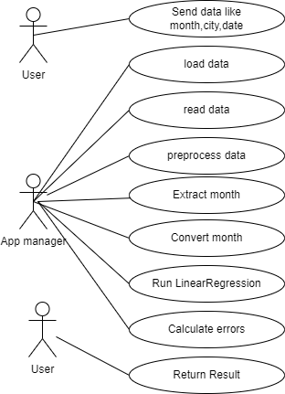
USE CASE DIAGRAM

Slide 13
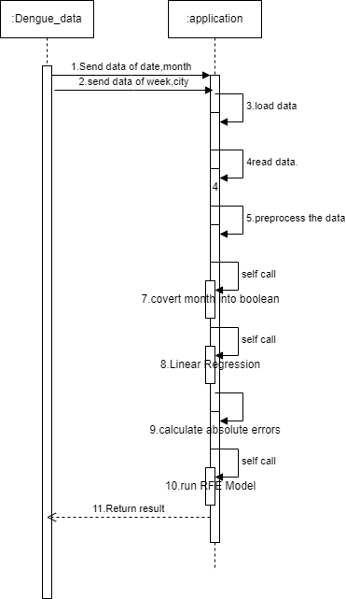
SEQUENCE DIAGRAM

Slide 14
TESTING TECHNIQUES
Unit Testing: Validates internal program logic.Tests individual software units after their completion.Ensures proper functioning of each unique path of a business process.Involves basic tests at the component level.
Integration Testing: Tests integrated software components to ensure they function as one program.Ensures that combined components work correctly and consistently.Focuses on exposing problems arising from the combination of components.
Functional Testing: Systematically demonstrates that functions are available as specified.Centers on valid and invalid input, exercising identified functions, and application outputs.Focuses on requirements, key functions, and special test cases.
System Testing: Ensures the entire integrated software system meets requirements.Tests a configuration to ensure known and predictable results.Emphasizes pre-driven process links and integration points.

Slide 15
TESTING TECHNOLOGIES
White Box Testing: Tester has knowledge of the inner workings, structure, or language of the software.Tests areas not reachable from a black box level.Used to test portions that require internal code access
Black Box Testing: Testing without knowledge of the internal workings, structure, or language of the software.Tests based on specifications or requirements.Treats the software as a 'black box' without considering its internal workings.
Unit Testing (Reiterated): Conducted as part of the combined code and unit test phase.Ensures code and unit tests are conducted in synchronization but can be separate phases.

Slide 16
CONCLUSION
In conclusion, this study embarked on the challenging task of predicting the price of Bitcoin, a highly volatile and rapidly evolving cryptocurrency, by employing time series analysis with an ARIMA model. Traditional financial prediction methods often fall short when applied to Bitcoin due to its unique characteristics and lack of seasonality. However, through the application of machine learning techniques, we have explored patterns and trends within Bitcoin's price data, striving to gain insights into its future price movements. While the results may not always provide perfect predictions, they underscore the potential of machine learning models in understanding and forecasting cryptocurrency markets.

Slide 17
FUTURE ENHANCEMENT
Advanced Machine Learning Algorithms and Deep Learning Models: Implementing sophisticated ML algorithms and deep learning models stands as a primary avenue for enhancing the accuracy of Bitcoin price predictions. These could significantly improv
Sentiment Analysis Integration: By including sentiment analysis from diverse sources like news, social media, and market sentiment, the model can gain valuable insights into market dynamics. This integration would further bolster the accuracy of price forecasts.e forecasting precision.
Expansion to Other Cryptocurrencies: Considering the interrelationships between Bitcoin and other cryptocurrencies offers a more holistic view of the entire cryptocurrency market. This expansion can lead to more comprehensive and nuanced predictions.
Real-Time Adaptive Models: Developing real-time prediction models capable of adjusting to changing market conditions would be highly beneficial. Given the volatility of cryptocurrency markets influenced by breaking news and events, adaptable models are crucial for accurate predictions.
Integration of Blockchain Analytics: Incorporating blockchain analytics and on-chain data into the prediction process can provide unique insights into Bitcoin's price movements. This could offer a deeper understanding of market behavior.

Slide 18
FUTURE ENHANCEMENT
Broader Economic and Regulatory Implications: Extending the research to explore the broader economic and regulatory implications of Bitcoin price predictions is essential. As Bitcoin gains prominence in global financial markets, accurate forecasting becomes a critical tool for both policy-makers and investors.
Refinement of Prediction Models: Continuously refining prediction models for higher accuracy.
Incorporation of Additional Data Sources: Integrating diverse data sources to enhance prediction capabilities.
Exploration of Global Economic and Financial Implications: Delving into the broader implications of Bitcoin price forecasts on the global economy and financial markets.

Slide 19
REFERENCES
[1] .Majeed, M.A.; Shafri, H.Z.M.; Zulkafli, Z.; Wayayok, A. A Deep Learning Approach for Dengue Fever Prediction in Malaysia Using LSTM with Spatial Attention. Int. J. Environ. Res. Public Health 2023, 20, 4130. https://doi.org/10.3390/ijerph20054130
[2] .Cabrera, M.; Leake, J.; Naranjo-Torres, J.; Valero, N.; Cabrera, J.C.; Rodríguez-Morales, A.J. Dengue Prediction in Latin America Using Machine Learning and the One Health Perspective: A Literature Review. Trop. Med. Infect. Dis. 2022, 7, 322. https://doi.org/10.3390/tropicalmed7100322
[3] .Dey, Samrat Kumar, et al. "Prediction of dengue incidents using hospitalized patients, metrological and socio-economic data in Bangladesh: A machine learning approach." PLoS One 17.7 (2022): e0270933.
[4] .Kakarla, S.G., Kondeti, P.K., Vavilala, H.P. et al. Weather integrated multiple machine learning models for prediction of dengue prevalence in India. Int J Biometeorol 67, 285–297 (2023). https://doi.org/10.1007/s00484-022-02405-z

Slide 20
REFERENCES
[5] .Sarder, Faysal, Sorefa Akter, and Sharmin Akter. "Predicting Dengue Outbreak from Climate Data Using Machine Learning Algorithms." 2022 IEEE International Conference on Data Science and Information System (ICDSIS). IEEE, 2022.
[6] .Anuranjan, M. B., et al. "Machine Learning Techniques for Predicting Dengue Outbreak." Innovations in Information and Communication Technologies: Proceedings of ICIICT 2022. Singapore: Springer Nature Singapore, 2022. 45-56.
[7] .Gupta, G.; Khan, S.; Guleria, V.; Almjally, A.; Alabduallah, B.I.; Siddiqui, T.; Albahlal, B.M.; Alajlan, S.A.; AL-subaie, M. DDPM: A Dengue Disease Prediction and Diagnosis Model Using Sentiment Analysis and Machine Learning Algorithms. Diagnostics 2023, 13, 1093. https://doi.org/10.3390/diagnostics13061093.

Slide 21


